Slide 1

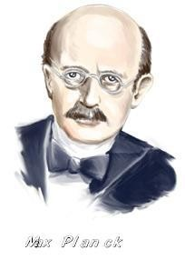
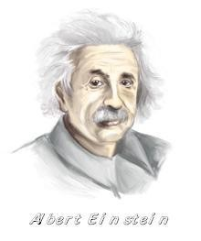
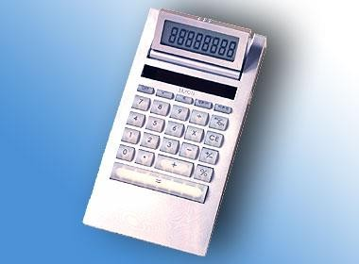
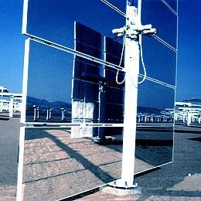
Blackbody Radiation

Slide 2
Need for Quantum Physics
Problems remained from classical mechanics that the special theory of relativity didn’t explain.
Attempts to apply the laws of classical physics to explain the behavior of matter on the atomic scale were consistently unsuccessful.
Problems included:
Blackbody radiation
The electromagnetic radiation emitted by a heated object
Photoelectric effect
Emission of electrons by an illuminated metal

Slide 3
Quantum Mechanics Revolution
Between 1900 and 1930, another revolution took place in physics.
A new theory called quantum mechanics was successful in explaining the behavior of particles of microscopic size.
The first explanation using quantum theory was introduced by Max Planck.
– Many other physicists were involved in other subsequent developments

Slide 4
Blackbody Radiation
An object at any temperature is known to emit thermal radiation.
Characteristics depend on the temperature and surface properties.
The thermal radiation consists of a continuous distribution of wavelengths from all portions of the em spectrum.
At room temperature, the wavelengths of the thermal radiation are mainly in the infrared region.
As the surface temperature increases, the wavelength changes.
It will glow red and eventually white.

Slide 5
Blackbody Radiation, cont.
The basic problem was in understanding the observed distribution in the
radiation emitted by a black body.
– Classical physics didn’t adequately describe the observed distribution.
A black body is an ideal system that absorbs all radiation incident on it. The electromagnetic radiation emitted by a black body is called
blackbody radiation.

Slide 6

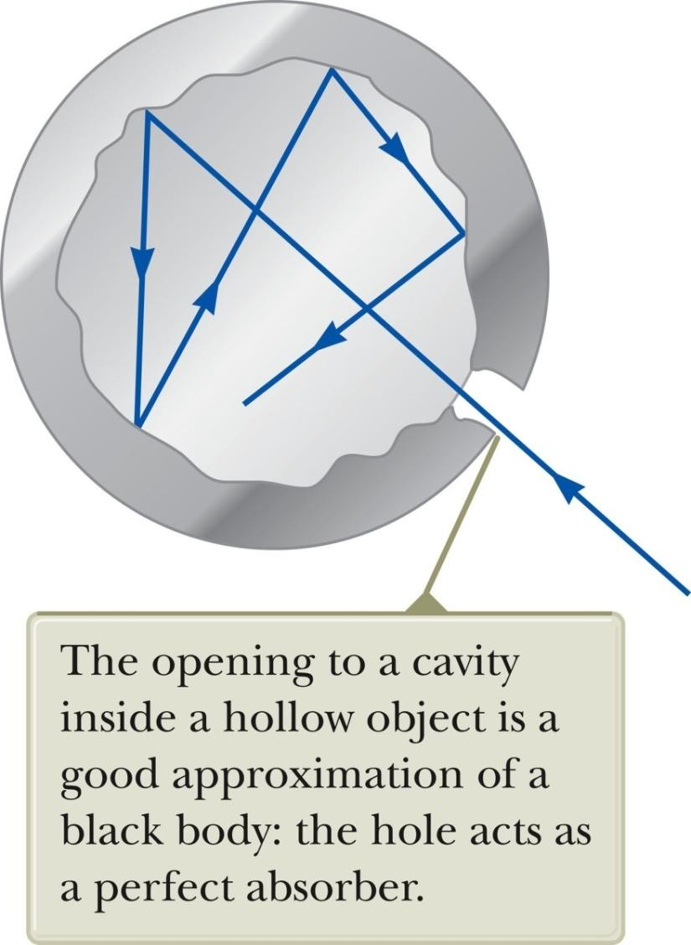
Blackbody Approximation
A good approximation of a black body is a small hole leading to the inside of a hollow object.
The hole acts as a perfect
absorber.
The nature of the radiation leaving the cavity through the hole depends only on the temperature of the cavity.

Slide 7
Blackbody Experiment Results
The total power of the emitted radiation increases with temperature.
Stefan’s law:
P = σ A e T⁴
The emissivity, e, of a black body is 1, exactly
The peak of the wavelength distribution shifts to shorter wavelengths as the temperature increases.
Wien’s displacement law
λ_{max}T = 2.898 x 10⁻³ m . K

Slide 8
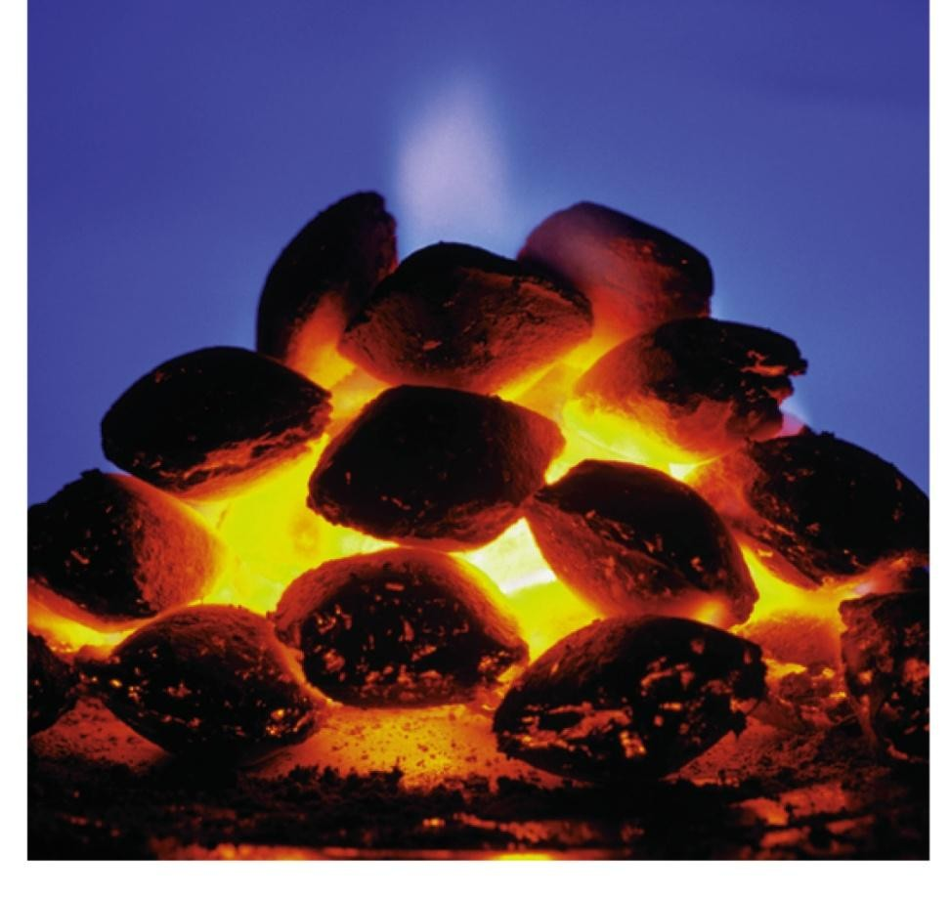
Intensity of Blackbody Radiation, Summary
The intensity increases with increasing temperature.
The amount increases temperature.
of radiation emitted with increasing
– The area under the curve
The peak wavelength decreases
with increasing temperature.

Slide 9
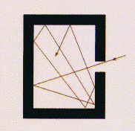
Definition of a black body
A black body is an ideal body which allows the whole of the incident radiation to pass into itself ( without reflecting the energy ) and absorbs within itself this whole incident radiation (without passing on the energy). This propety is valid for radiation corresponding to all wavelengths and to all angels of incidence. Therefore, the black body is an ideal absorber of incident radaition.
Univ. of Oregon web site
Notes:
An oven with a small opening produces a very good blackbody spectrum.

Slide 10
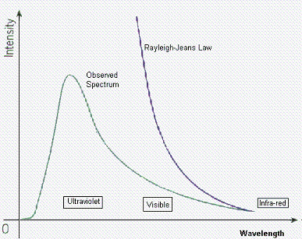
Black-Body Radiation Laws (1)
1- The Rayleigh-Jeans Law.
* It agrees with experimental measurements for long wavelengths.
* It predicts an energy output that diverges towards infinity as wavelengths grow smaller.
* The failure has become known as the ultraviolet catastrophe.
http://www.egglescliffe.org.uk/physics/astronomy/blackbody/Image22c.gif

Slide 11
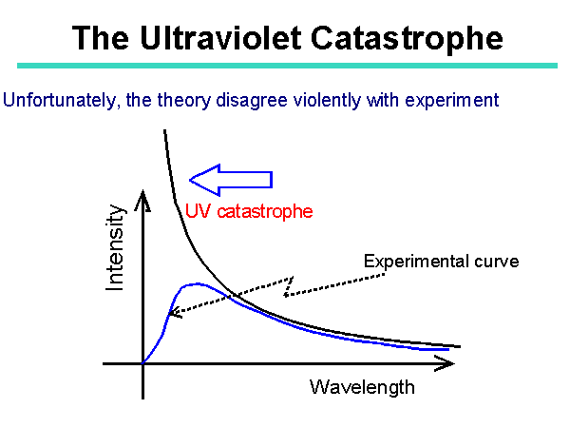
Ultraviolet Catastrophe
This formula also had a problem. The problem was the term in the denominator.
For large wavelengths it fitted the experimental data but it had major problems at shorter wavelengths.
http://theory.uwinnipeg.ca/users/gabor/foundations/quantum/images/slide5.gif

Slide 12
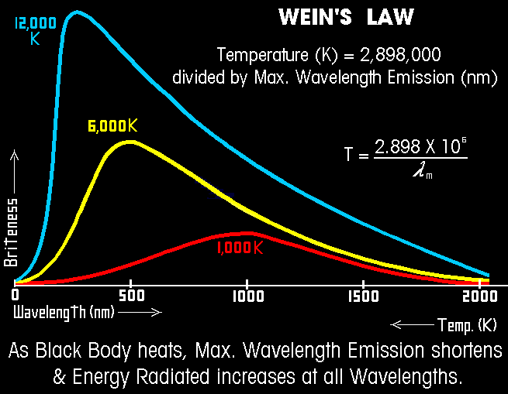
Black-Body Radiation Laws (3)
3- Wein Displacement Law
- It tells us as we heat an object up, its color changes from red to orange to white hot.
- You can use this to calculate the temperature of stars.
The surface temperature of the Sun is 5778 K, this temperature corresponds to a peak emission = 502 nm = about 5000 Å.
- b is a constant of proportionality, called Wien's displacement constant and equals 2.897 768 5(51) × 10^{–3} m K = 2.897768 5(51) × 10⁶ nm K.
http://www.rumford.com/radiant/images/Wiengraph.gif

Slide 13
Rayleigh-Jeans Law
An early classical attempt to explain blackbody radiation was the
Rayleigh-Jeans law.
_{I ( λ,T ) =} 2π c k_{B}T
_{λ}4
At long wavelengths, the law matched experimental results fairly well.

Slide 14

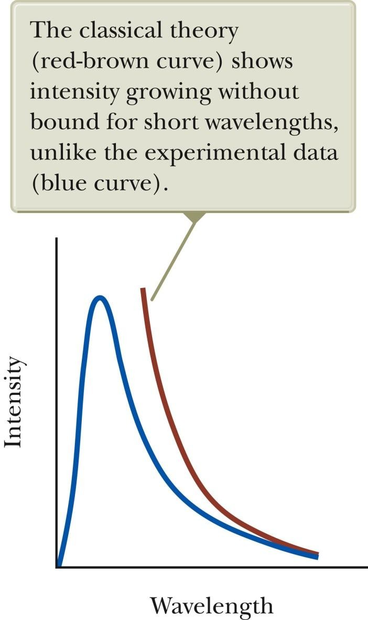
Rayleigh-Jeans Law, cont.
At short wavelengths, there was a major disagreement between the Rayleigh-Jeans law and experiment.
This mismatch
known as the
became
ultraviolet
catastrophe.
– You would have infinite energy as the wavelength approaches zero.

Slide 15
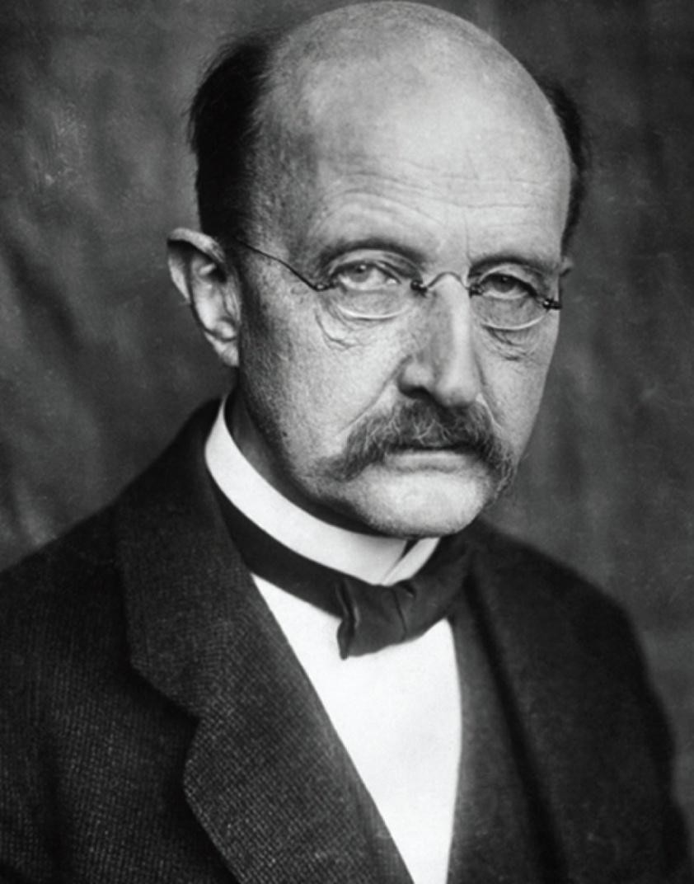
Max Planck
1858 – 1847
German physicist
Introduced the concept of “quantum of action”
In 1918 he was awarded the Nobel Prize for the discovery of the quantized nature of energy.

Slide 16
Planck’s Theory of Blackbody Radiation
In 1900 Planck developed a theory of blackbody radiation that leads to an equation for the intensity of the radiation.
This equation is in complete agreement with experimental observations. He assumed the cavity radiation came from atomic oscillations in the cavity walls.
Planck made two assumptions about the nature of the oscillators in the
cavity walls.

Slide 17
Planck’s Assumption, 1
The energy of an oscillator can have only certain discrete values E_{n.}
E_{n} = n h ƒ
n is a positive integer called the quantum number
ƒ is the frequency of oscillation
h is Planck’s constant
This says the energy is quantized.
Each discrete energy value corresponds to a different quantum state.
Each quantum state is represented by the quantum
number, n.

Slide 18
Planck’s Assumption, 2
The oscillators emit or absorb energy when making a transition from one quantum state to another.
The entire energy difference between the initial and final states in the transition is emitted or absorbed as a single quantum of radiation.
An oscillator emits or absorbs energy only when it changes quantum states.
The energy carried by the quantum of radiation is E = h ƒ.

Slide 19
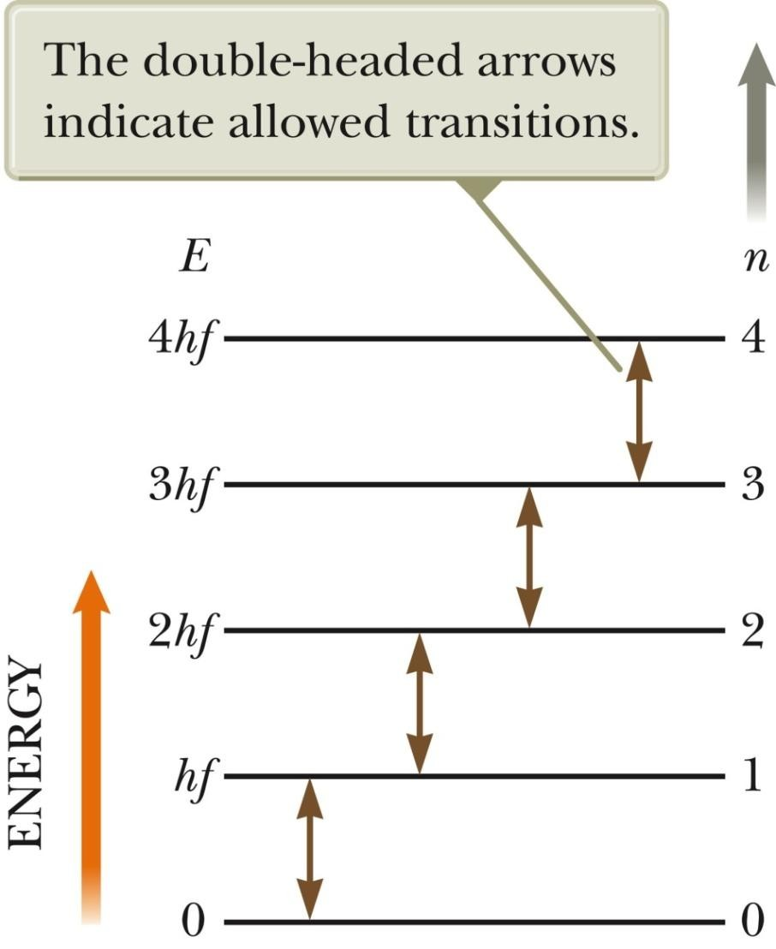
Energy-Level Diagram
An energy-level diagram shows the quantized energy levels and allowed transitions.
Energy is on the vertical axis. Horizontal lines represent the
allowed energy levels.
The double-headed arrows indicate allowed transitions.

Slide 20
More About Planck’s Model
The average energy of a wave is the average energy difference between levels of the oscillator, weighted according to the probability of the wave being emitted.
This weighting is described by the Boltzmann distribution law and gives
the probability of a state being occupied as being proportional to
where E is the energy of the state.
_{e}−E k_{B}T

Slide 21

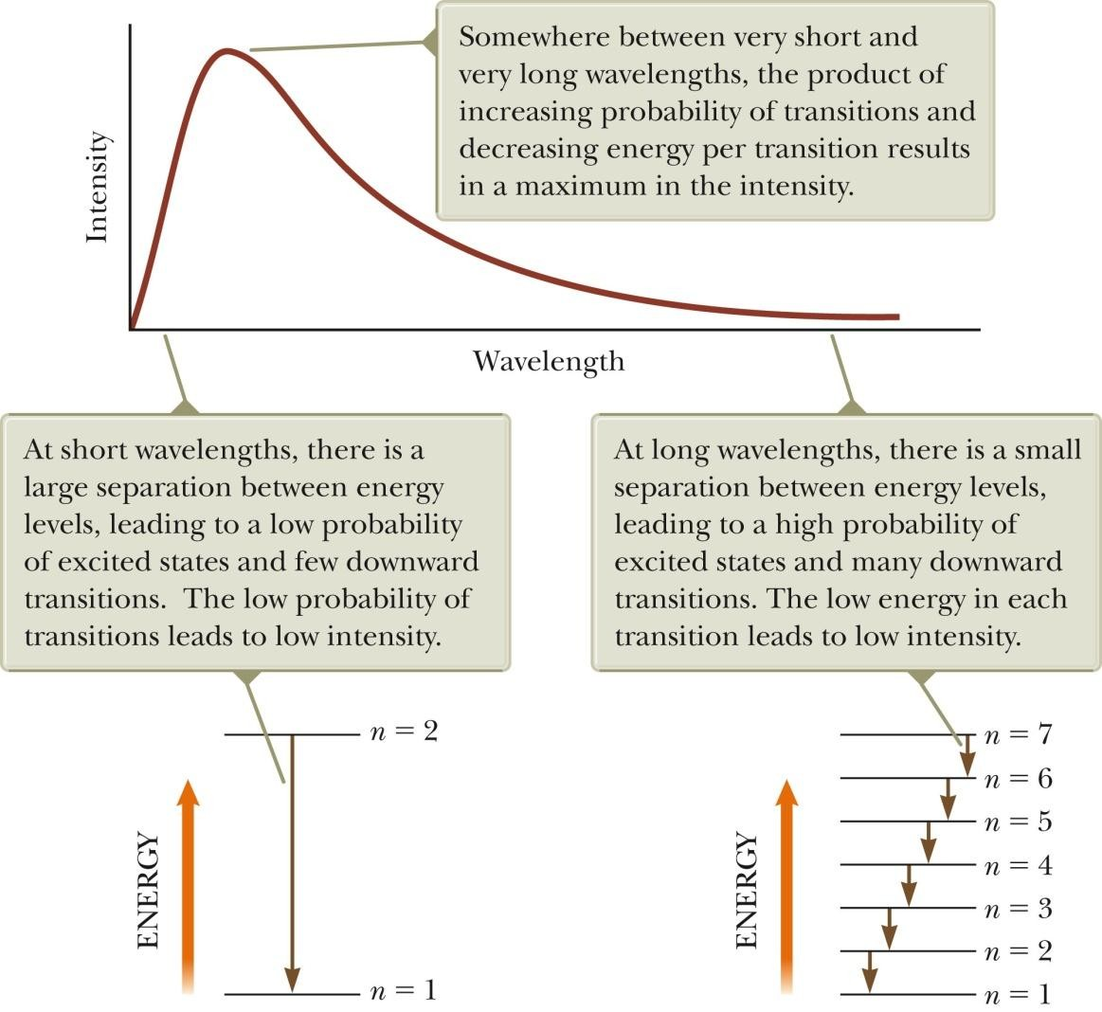
Planck’s Model, Graph

Slide 22
Planck’s Wavelength Distribution Function
Planck generated a theoretical expression for the wavelength distribution.
I ( λ,T ) =
2πhc²
_{λ}5 _{(e}hc λk_{B}T
−1)
– h = 6.626 x 10⁻³⁴ J.s
– h is a fundamental constant of nature.
At long wavelengths, Planck’s equation reduces to the Rayleigh-Jeans expression.
At short wavelengths, it predicts an exponential decrease in intensity with
decreasing wavelength.
– This is in agreement with experimental results.

Slide 23
Einstein and Planck’s Results
Einstein re-derived Planck’s results by assuming the oscillations of the electromagnetic field were themselves quantized.
In other words, Einstein proposed that quantization is a fundamental property of light and other electromagnetic radiation.
This led to the concept of photons.

Slide 24

































Planck’s quantum theory
Classical theory of black body radiation
Black body is defined as an ideal system that absorbs all the radiation incident on it. The electromagnetic (EM) radiation emitted by the black body is called black body radiation.
From the black body experiment, the distribution of energy in black body, E depends only on the temperature, T.
E = k_{B}T (1.1)
where k_{B} : Boltzmann' s constant
T : temperature in kelvin
If the temperature increases thus the energy of the black body
increases and vice versa.

Slide 25
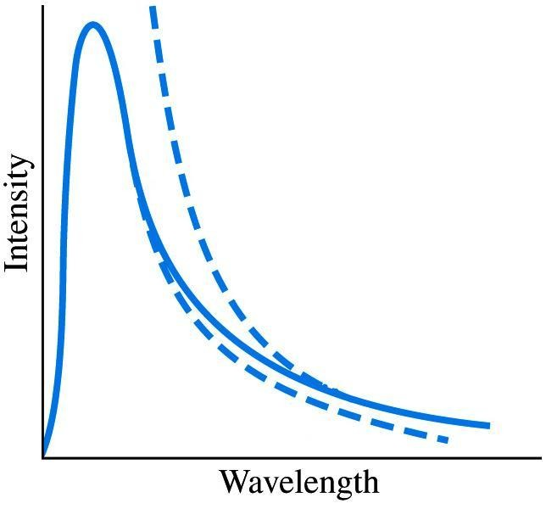


The spectrum
of EM radiation emitted by the black body
(experimental result) is shown in Figure.
Experimental result
Rayleigh -Jeans
theory
Wien’s theory
Classical physics
From the curve, Wien’s theory was accurate at short wavelengths but deviated at longer wavelengths whereas the reverse was true for the Rayleigh-Jeans theory.

Slide 26








The Rayleigh-Jeans and Wien’s theories failed to fit the experimental curve because this two theories based on classical ideas which are
Energy of the EM radiation is not depend on its
frequency or wavelength.
Energy of the EM radiation is continuously.

Slide 27

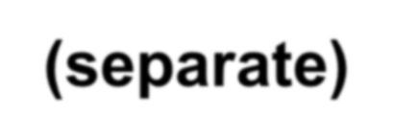







In 1900, Max Planck proposed his theory that is fit with the experimental curve in Figure at all wavelengths known as Planck’s quantum theory.
The assumptions made by Planck in his theory are :
The EM radiation emitted by the black body is in discrete (separate) packets of energy. Each packet is called a quantum of energy. This means the energy of EM radiation is quantised.
The energy size of the radiation depends on its
frequency.

Slide 28



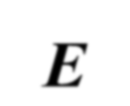
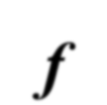













According to this assumptions, the quantum of the energy E for radiation of frequency f is given by
E = hf
(1.2)
where h : Planck' s constant = 6.63×10⁻³⁴ J s
Since the speed of EM radiation in a vacuum is
c = λf
then eq. (1.2) can be written as
_{E =} hc
(1.3)
λ
From eq. (1.3), the quantum of the energy E for
DR.ATrAaRd@iaUtiTioM.nNS is inversePlHyY3p10r-oMpodoerrntPiohynsicasl to its wavelength. 25

Slide 29



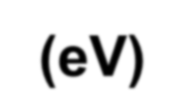













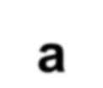


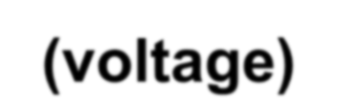





It is convenient to express many quantum energies in
electron-volts.
The electron-volt (eV) is a unit of energy that can be defined as the kinetic energy gained by an electron in being accelerated by a potential difference (voltage) of 1 volt.
Unit conversion:
1eV = 1.60×10⁻¹⁹ J
In 1905, Albert Einstein extended Planck’s idea by proposing that electromagnetic radiation is also quantised. It consists of particle like packets (bundles) of energy called photons of electromagnetic radiation.
Note:
For EM radiation of n packets, the energy E_{n} is given by
E = nhf
(1.4)
n
where n : realnumber =1,2,3,...
29

Slide 30

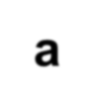

















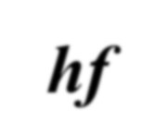












Photon
Photon is defined
as a particle with zero mass
consisting of a quantum of electromagnetic
radiation where its energy is concentrated.
A photon may also be regarded as a unit of energy equal to hf.
Photons travel at the speed of light in a vacuum. They are required to explain the photoelectric effect and other phenomena that require light to have particle property.
Table shows the differences between the photon and
electromagnetic wave.
30

Slide 31
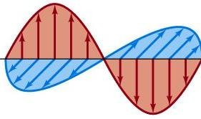
EM Wave | Photon
Energy of the EM wave depends on the intensity of the wave. Intensity of the wave I is proportional to the squared of its amplitude A² where I ∝ A² | Energy of a photon is proportional to the frequency of the EM wave where E ∝ f
Its energy is continuously and spread out through the medium as shown in Figure 9.2a. | Its energy is discrete as shown in Figure 9.2b. Photon
31

Slide 32
Example 1 :
A photon of the green light has a wavelength of 740 nm.
Calculate
the photon’s frequency,
the photon’s energy in joule and electron-volt.
(Given the
c =3.00×10⁸
speed of _{m s}−1
light in the and Planck’s
vacuum, constant,
h =6.63×10⁻³⁴ J s)
32

Slide 33


Solution :
λ = 740 ×10⁻⁹ m
a. The frequency of the photon is given by
3.00 ×10⁸ = (740 ×10⁻⁹ )f
f = 4.05 ×10¹⁴ Hz
c = λf
b. By applying the Planck’s quantum theory, thus the photon’s
energy in joule is
E = hf
E = (6.63×10⁻³⁴ )(4.05 ×10¹⁴ )
E = 2.69 ×10⁻¹⁹ J
and its energy in electron-volt is
2.69 ×10⁻¹⁹
E =
1.60 ×10⁻¹⁹
E = 1.66 eV
33

Slide 34
Example 2 :
For a gamma radiation of wavelength 4.62×10⁻¹² m
propagates in the air, calculate the energy of a photon for gamma radiation in electron-volt.
(Given the speed of light in the vacuum, c =3.00×10⁸ m s⁻¹ and Planck’s constant, h =6.63×10⁻³⁴ J s)
34

Slide 35

λ = 4.62 ×10⁻¹² m
Solution :
By applying the Planck’s quantum theory, thus the energy of a photon in electron-volt is
(6.63 ×10⁻³⁴ )(3.00 ×10⁸ )
_{E =} hc
E =
λ
4.62 ×10⁻¹²
E = 4.31×10⁻¹⁴ J
₌ 4.31×10⁻¹⁴
1.60 ×10⁻¹⁹
E = 2.69 ×10⁵ eV
35

Slide 36


Thank You
36

